Slide 1
Software Diagrams
Parameswari Ettiappan

Slide 2
Goals
Software Modeling Diagrams and Tools

Slide 3

Different types of diagrams in software

Slide 4
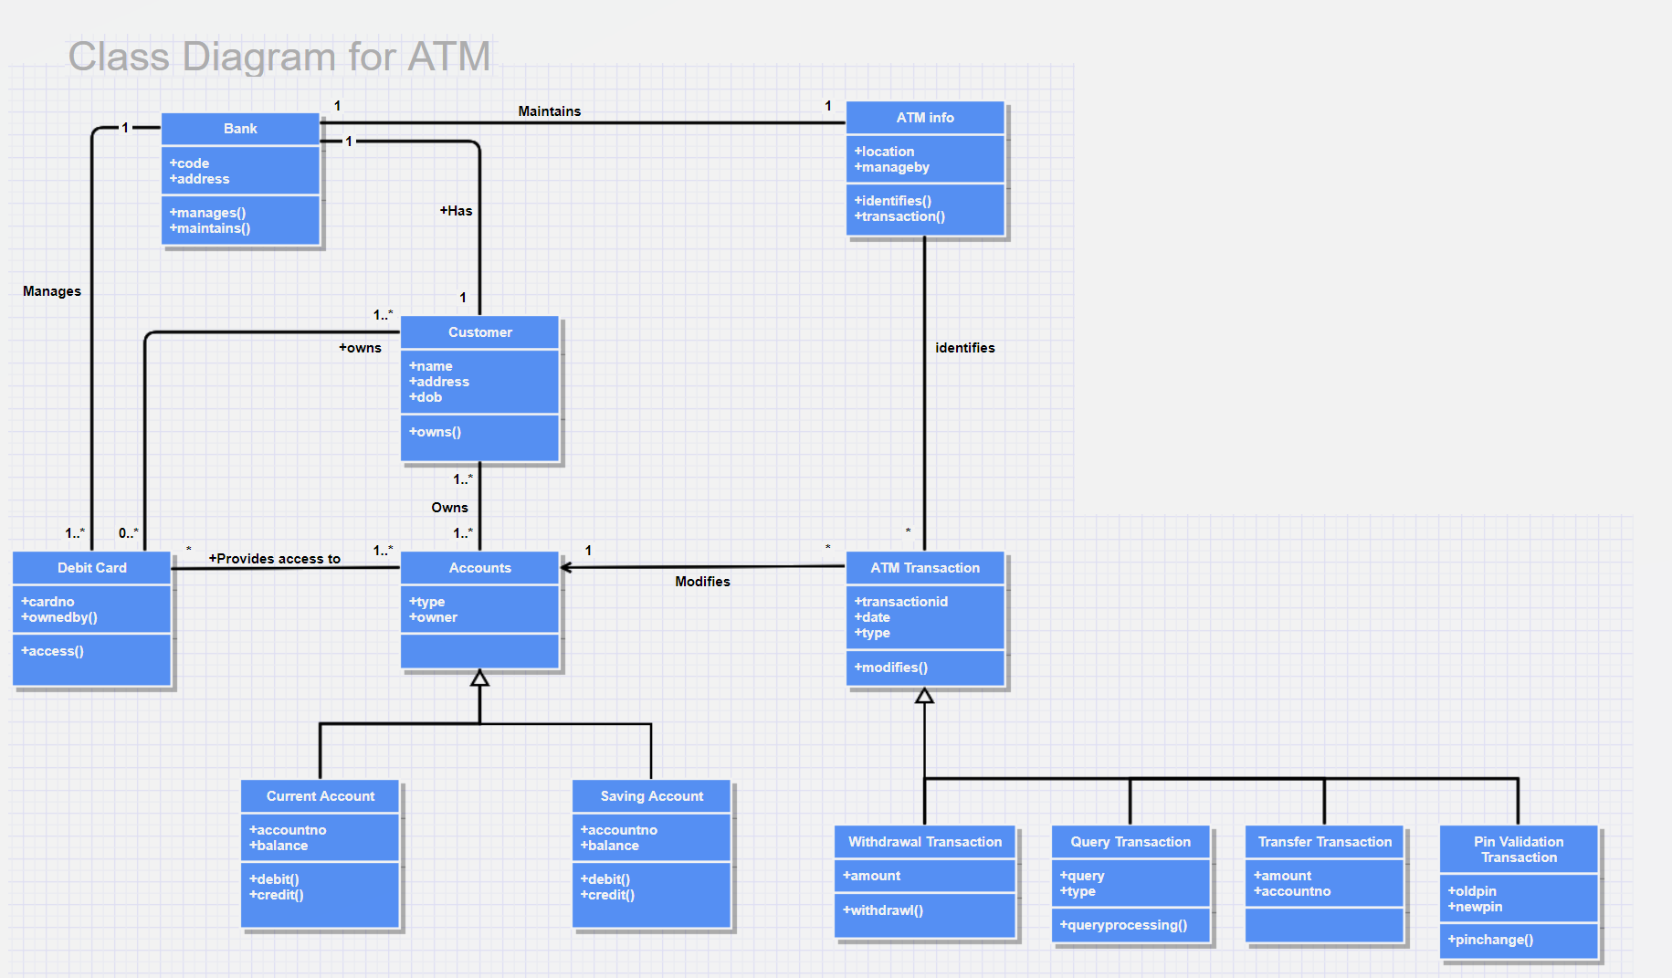
Different types of diagrams in software

Slide 5
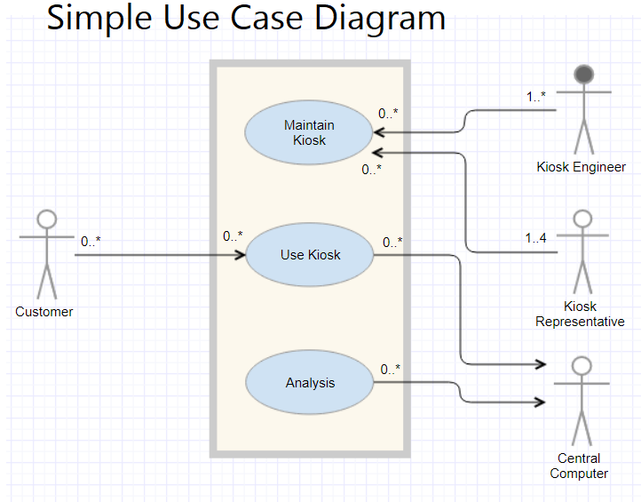
Different types of diagrams in software

Slide 6
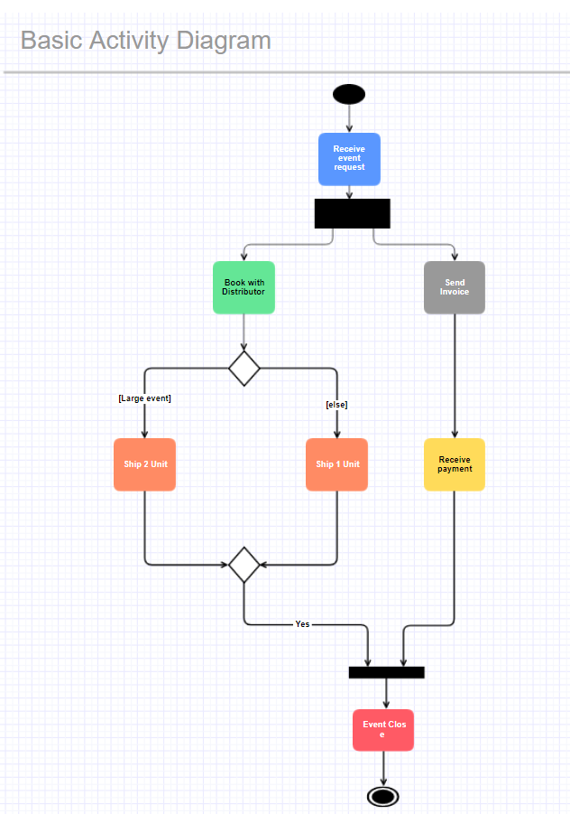
Different types of diagrams in software

Slide 7
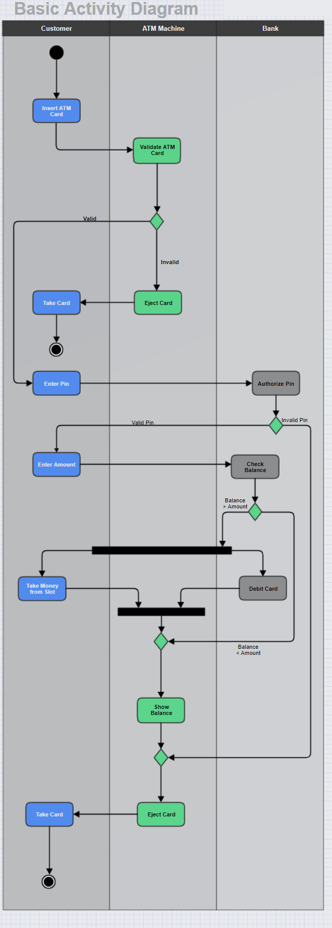
Different types of diagrams in software

Slide 8
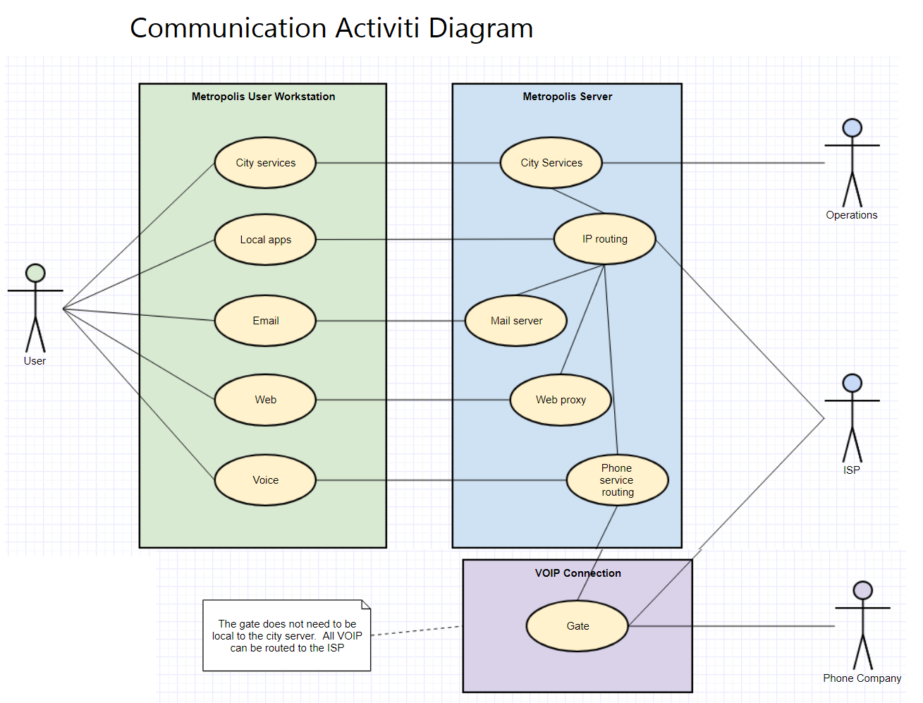
Different types of diagrams in software

Slide 9
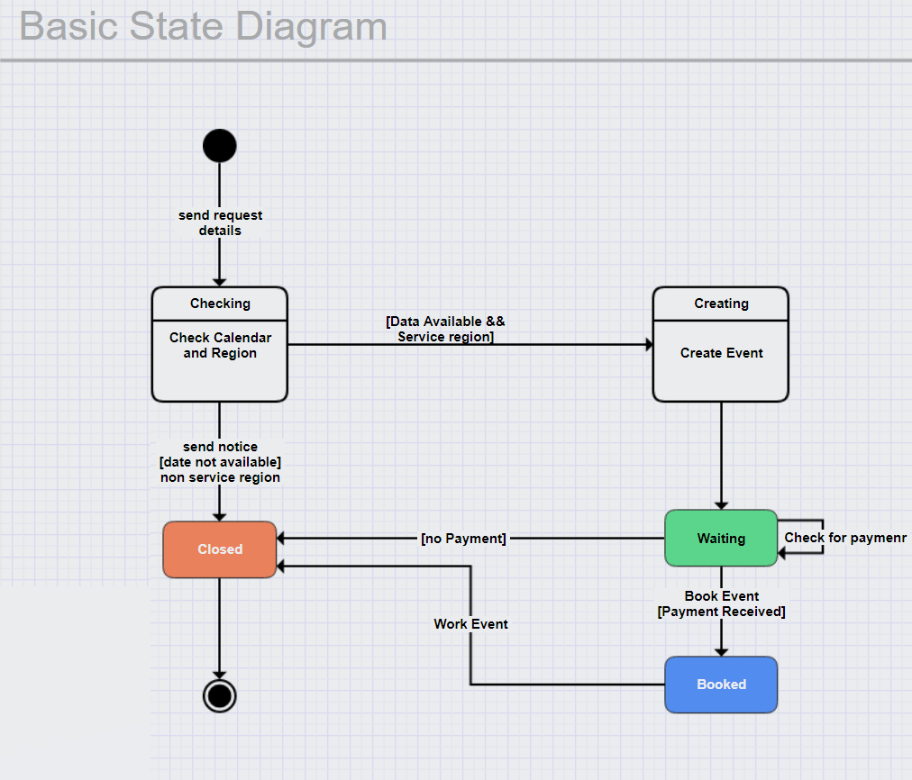
Different types of diagrams in software

Slide 10
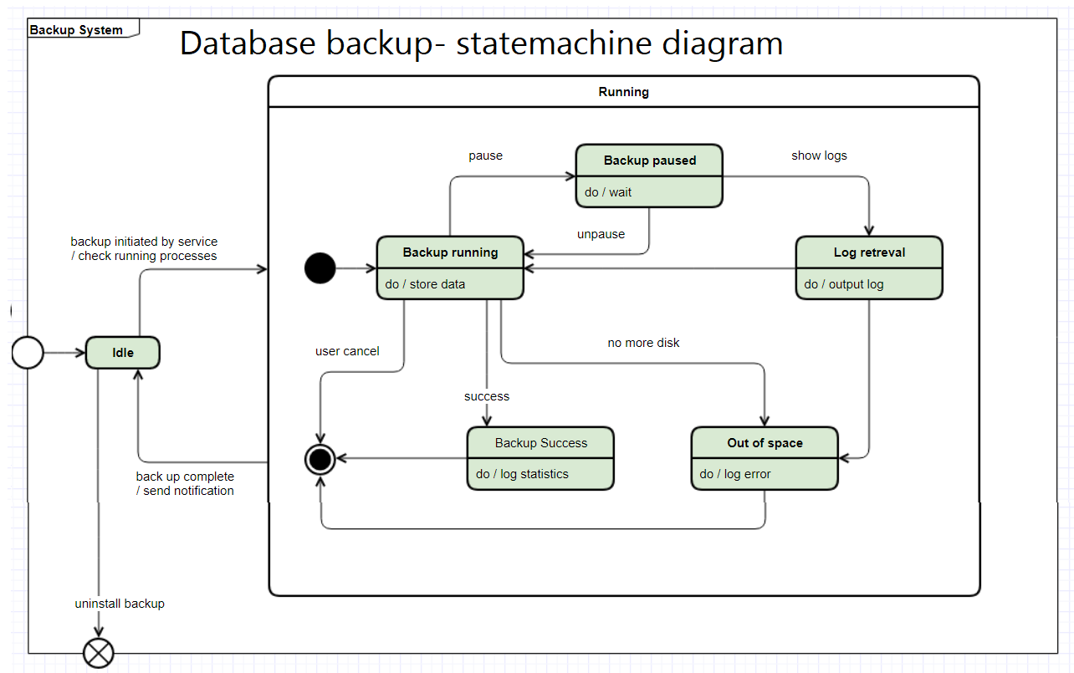
Different types of diagrams in software

Slide 11
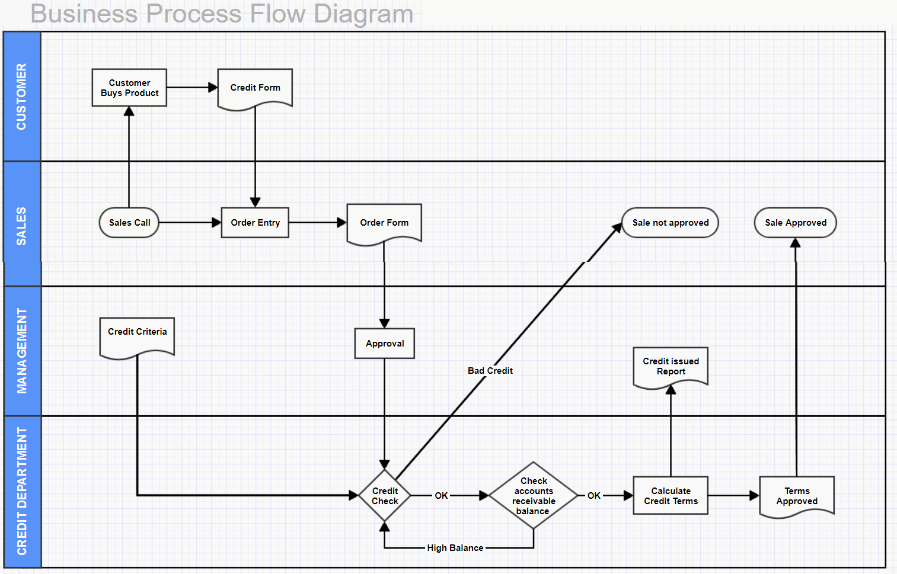
Different types of diagrams in software

Slide 12
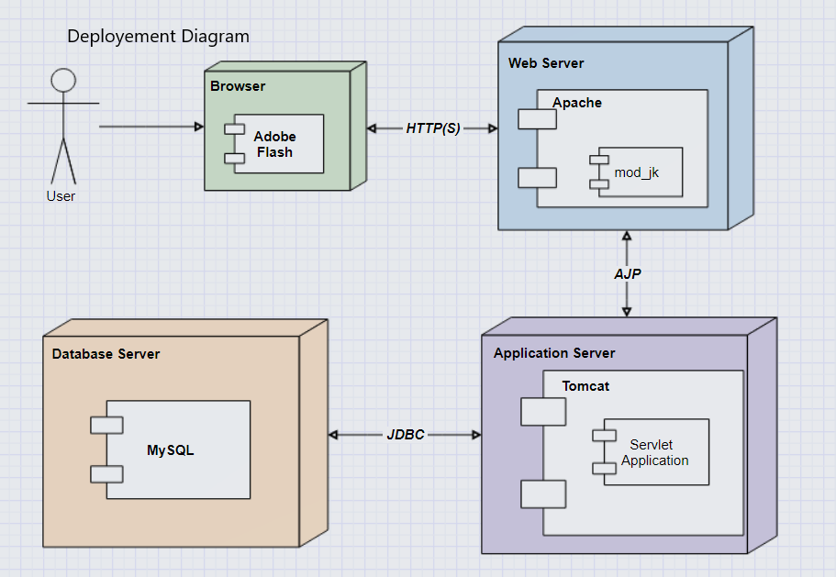
Different types of diagrams in software

Slide 13
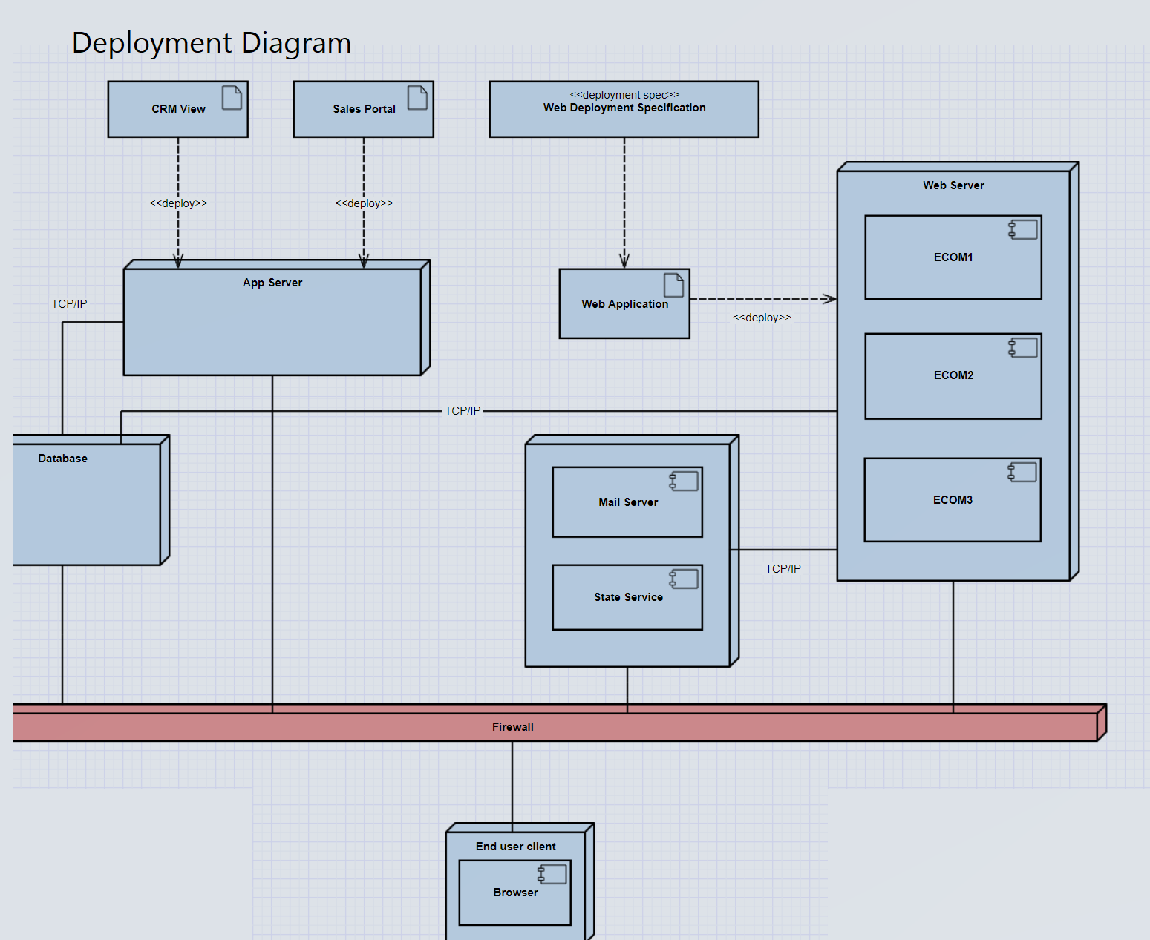
Different types of diagrams in software

Slide 14
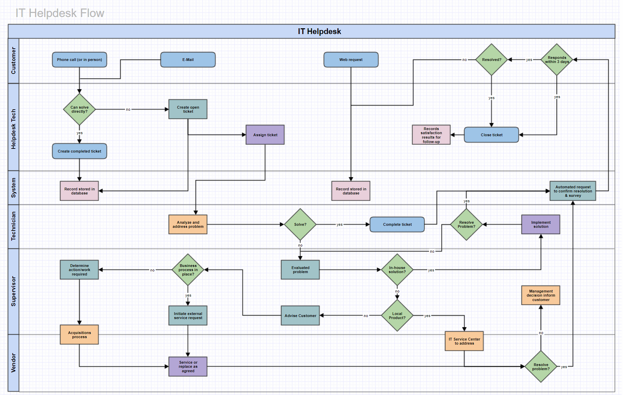
Different types of diagrams in software

Slide 15
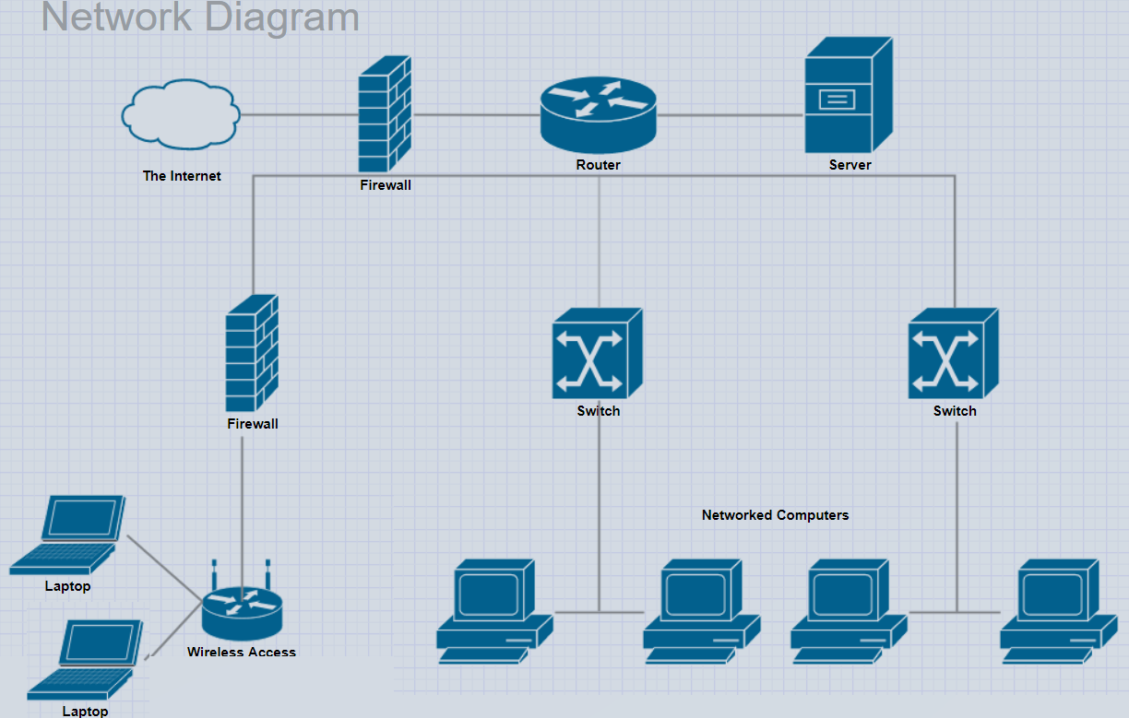
Different types of diagrams in software

Slide 16
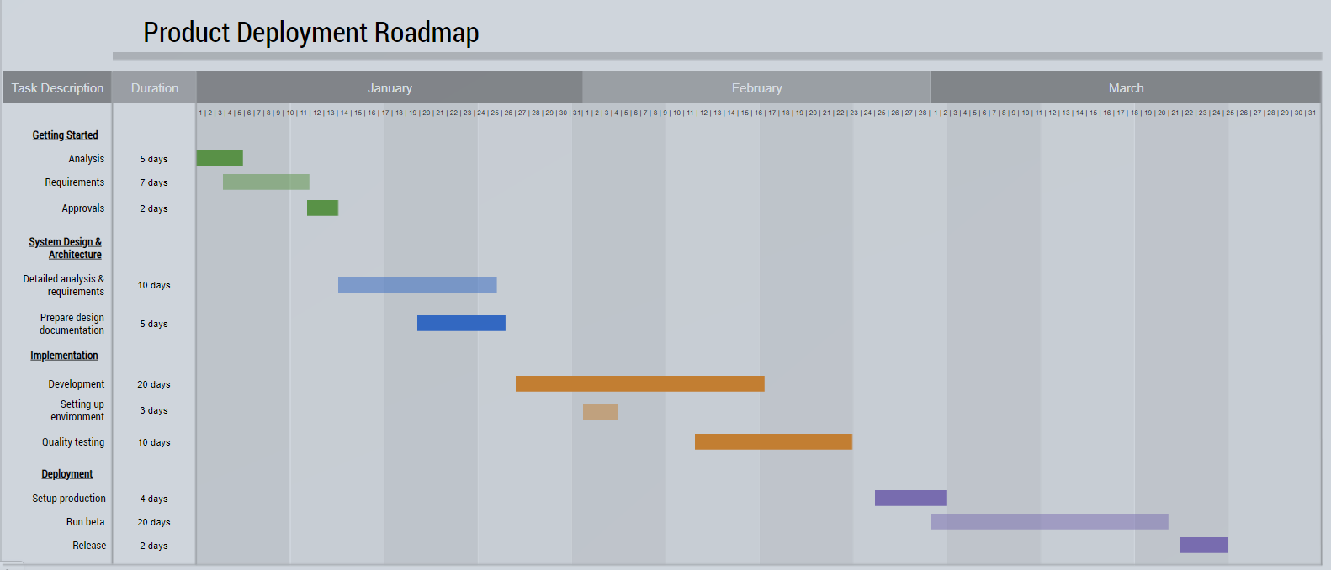
Different types of diagrams in software

Slide 17
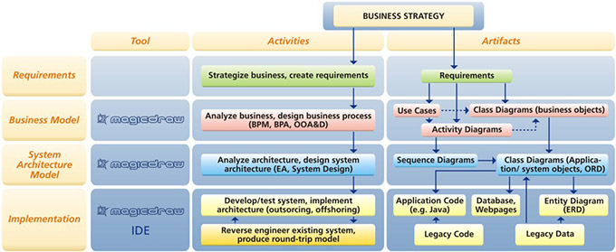
Software Engineering
Magicdraw

Slide 18
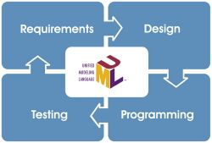
Software Engineering

Slide 19
Banking Case Study
Models

Slide 20
Tools
Draw.io
Gliffy
Edraw Max
Cacoo
ProcessOn
Lucidchart
Creately
Coggle

Slide 21
Tools
Mindmeister
yED
SmartDraw
Visual Paradigm
Terrastruct

Slide 22
Draw.io
Draw.io helps you to create a flow chart or any diagram with plenty of shapes to correctly visualize your infrastructure.
There are more than 50 pre-defined templates to get you started in various categories.

Slide 23
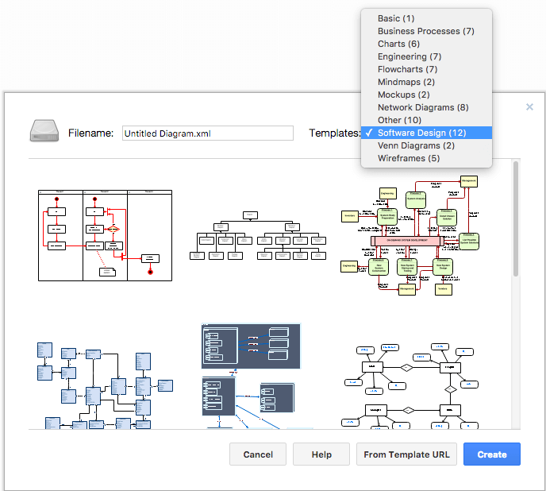
Draw.io

Slide 24
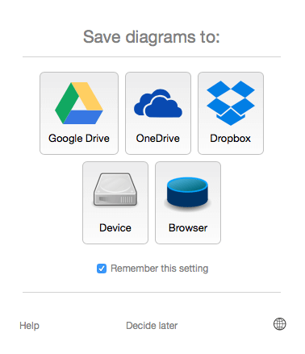
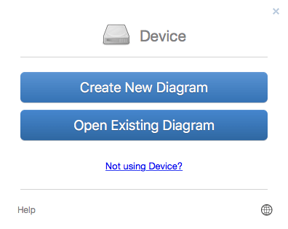
Draw.io

Slide 25
Gliffy
Gliffy is a fantastic drawing tool, which helps you create multiple types of a diagram like Flow Chart, Org Chart, Venn Diagram, Wireframe, Mindmap, Network design, etc.
The user interface is similar to Draw.io. However, I see more shapes in color, which is very handy and looks attractive.

Slide 26
Edraw Max
Trusted by companies like Samsung, Dell, and IBM, Edraw Max can help you create visual-presentation in literally minutes.
Just choose a visualization element and then add your data via spreadsheets or their simple sidebar.
Once you’re done, you can share it on social media or add them to your documents, slides, or website.

Slide 27
Edraw Max
They have over 1,000 templates in different areas, like:
Flowchart
Timeline
Infographic
Brochure
Network visualization
Floor plan
Engineering plan
https://youtu.be/neTfPiHhee8

Slide 28
Cacoo
Cacoo is fantastic if you are looking for real-time collaboration with drag-n-drop, grids, and revision history. It allows you to create 25 sheets with a free plan and can export in PNG format.

Slide 29
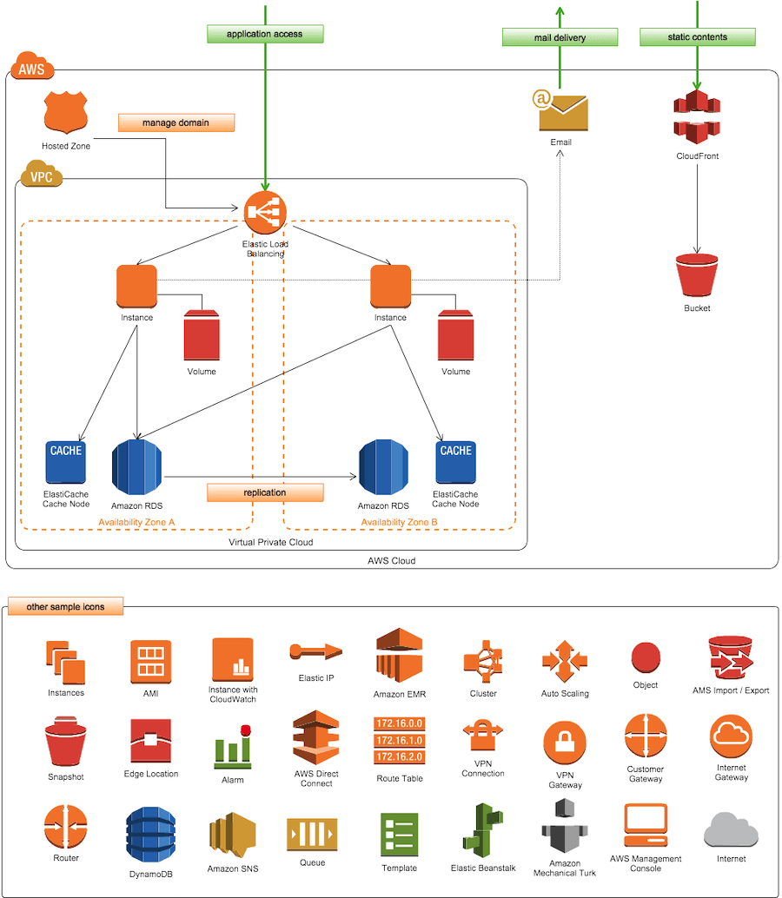
Cacoo

Slide 30
Cacoo

Slide 31
ProcessOn
ProcessOn is another flexible online tool to help you with creating UI Mockups, Mind Maps, Flowcharts, and UML.

Slide 32
Lucidchart
Lucidchart is freemium, and the free plan comes with basic functionality but good to start with.
You can select from more than 100 premade templates in the following categories.
Network
Network infrastructure
Mindmap
Engineering
Business analysis
Sitemap
Org chart
Flowchart
Wireframe

Slide 33
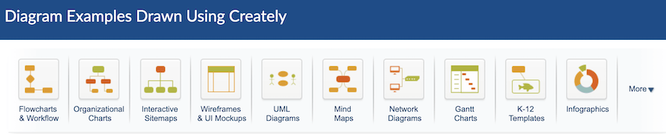
Creately
You can create one project and five diagrams in a free account with Creately. Creately let you draw a flowchart, organizational chart, wireframe, network diagram, infographics, and much more.
It’s a complete drag-n-drop, so creating an infrastructure diagram or flowchart is easy.

Slide 34
Coggle
Work together with your team to create a flowchart and mind maps using Coggle. Some of the features are as follows.
Add multiple starting points to the diagram
Upload custom images
Annotate text or image
Numerous shapes and design elements
Once you are happy with your diagram, you can download them as PDF or image files. And, also export as .mm or Visio files.
Demo

Slide 35
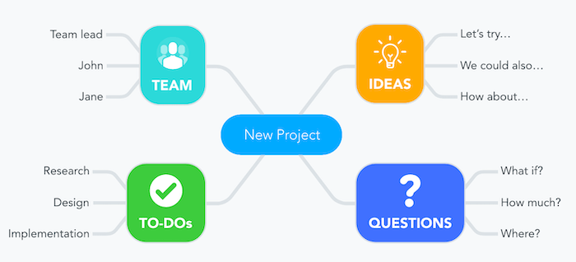
Mindmeister
Mindmeister for brainstorming, project planning, knowledge management, idea management, notes taking, and more.

Slide 36
yED
Add your branding color palette
Add custom data
Share with others
UML diagram editor
Graph structure grouping

Slide 37
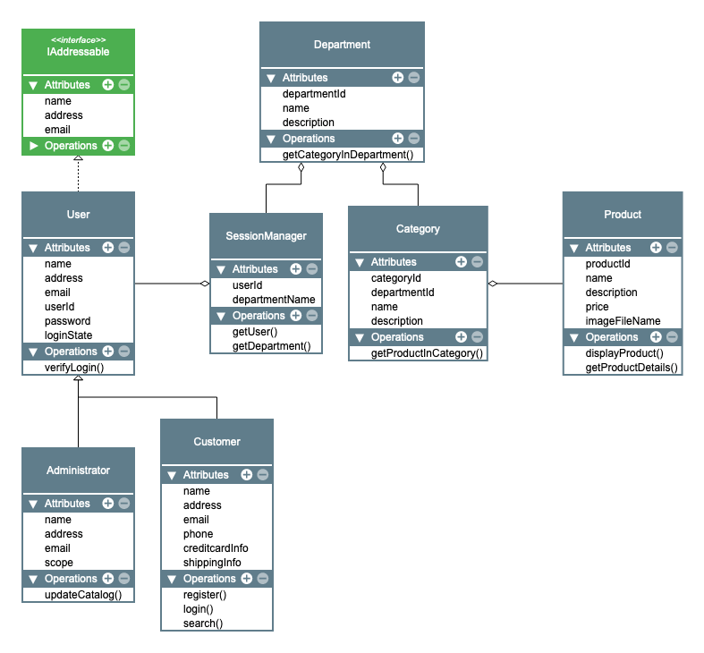
yED

Slide 38
yED
https://www.yworks.com/yed-live/

Slide 39
SmartDraw
With thousands of templates, tools, and symbols, SmartDraw should definitely be in your radar of consideration. You can create enormous amounts of elements, like:
Flowcharts
Floor plans
Network diagrams
Graphs
CAD drawings
Wireframes
And so much more

Slide 40
SmartDraw
https://www.youtube.com/watch?v=0FJf1NNmcyY&feature=youtu.be

Slide 41
Visual Paradigm
You can collaborate with your team members and build projects under one workplace.
Either start from scratch or select from a variety of pre-made templates.
You also get over 2,000 examples of diagrams, which can help when you’re stuck and need ideas.

Slide 42
Terrastruct
Terrastruct lets you express the complexity of your software designs.
You can layer your diagrams by the level of abstraction and define scenarios to capture how your system behaves under edge cases.
There are integrations with your codebase, the ability to collaborate through comments right on the diagram.

Slide 43
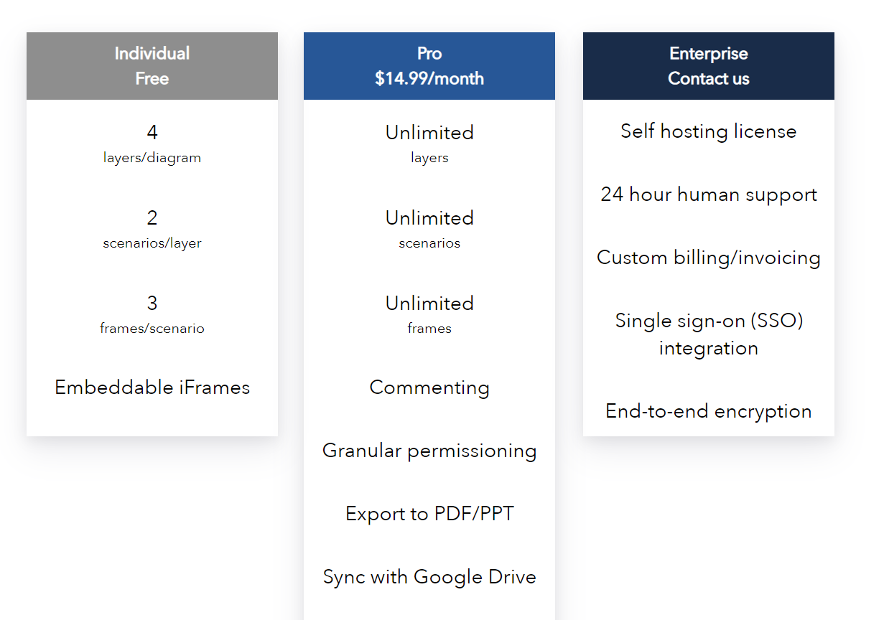
Terrastruct

Slide 44
Terrastruct
Demo

Slide 45
EDraw

Slide 46
Questions

Slide 47
Module Summary
UML

